Slide 1
BT4222 Project Proposal
By Recommendation System Group 7
Aarushi Mundra
Dylan Wo Qiying
Kaavya Senthil Kumar
Kenny Low Sheng Wei
Ng Wei Han
Tasneem Benazir

Slide 2
Table of contents
01
02
03
04
05
06
Movie Recommendations System Case Study
E-Commerce Case Studies
Main ML related challenges addressed
Defining ML Problem, Goal
Outline of subtasks
Potential contributions

Slide 3
01
Movie Recommendations System Case Study

Slide 4
Business Problems and ML Goals
Business Goal: Evaluate the quality of search results and offer user items that are highly relevant to their queries or aligned with their browsing history.
ML Goal: Predict individual preferences and behavior and provide tailored recommendations.

Slide 5
Highlights on Data Processing
Weighted Rating: Involves the use of calculating a movie’s rating based on number of votes.
Minimum Number of Votes Required: Used to filter out more rarely rated movies in the dataset.

Slide 6
Typical Machine Learning Methods
Demographic Filtering: Recommends movies to users with similar demographic features.
Content Based Filtering: Recommendations are made based on each user’s historical preferences
Memory Based Collaborative Filtering: Recommendations are made based on sets of similarity scores computed using cosine similarity or pearson correlation.

Slide 7
02
eCommerce Case Studies

Slide 8
Business Problems and ML Goals
Business Goal: Boost sales through having more tailored recommendations according to consumer’s on-site activity and purchase history.
ML Goal: Predict e-commerce clicks, cart additions and orders and provide apt recommendations through these events.

Slide 9
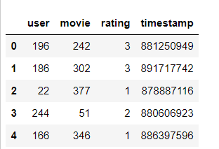
Highlights on Data Processing
Composite Feature Generation: Combine features and/or create new features from existing ones
Eg. here we can try to make a new feature “time since last review” to see if it is of importance

Slide 10
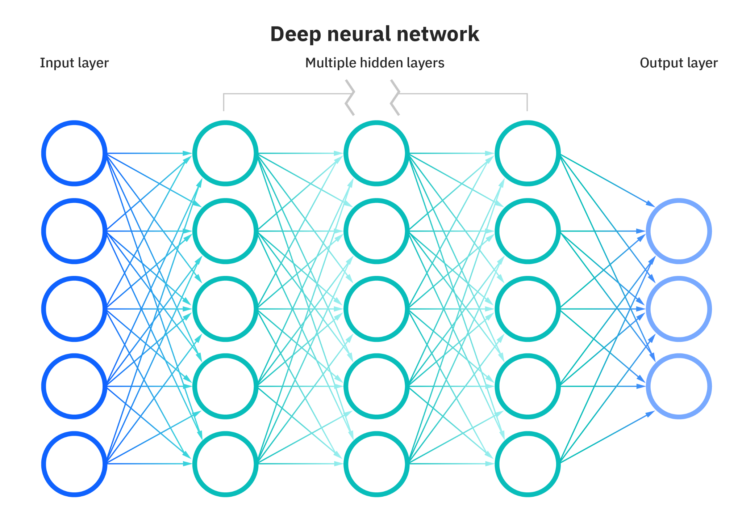
Typical Machine Learning Methods
Model Based Collaborative Filtering
Click on Shoes | Click on Socks
Click on Socks | Click on Shoes
Click on Socks | Buy Socks
Buy Socks | Click on Shoes
Max Recall@k
High computing power !

Slide 11

Typical Machine Learning Methods
Model Based Collaborative Filtering
Basic, singular implementation of models
Complex, built using multiple models
Hybrid approaches

Slide 12
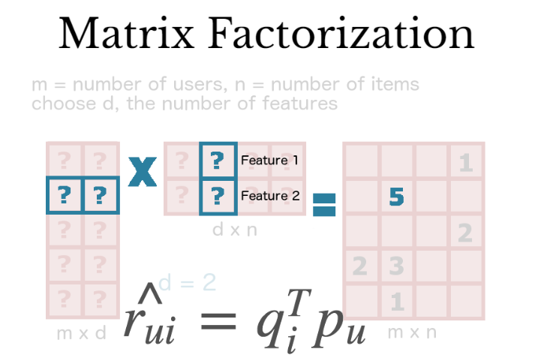
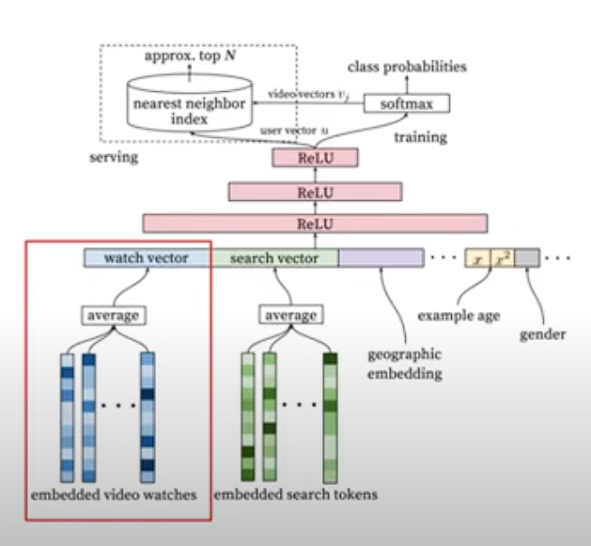
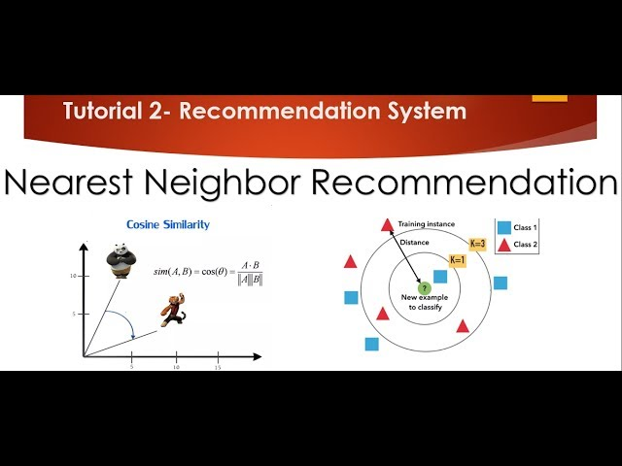
Typical Machine Learning Methods
Model Based Collaborative Filtering
SVD
ALS

Slide 13
03
Main ML related challenges

Slide 14
Challenges
(Movie)
Model | Demographic Filtering | Content Based Filtering | User-based Collaborative Filtering | Item-based Collaborative Filtering
Challenge(s) | Can’t take into account user sentiments | Can’t capture tastes and provide recommendations across genres. | User’s preference might change over time. Precomputation of matrix based on their neighboring users may lead to bad performance | Scalability - Computation grows with every new customer and item Sparsity - Difficulty in finding sufficient reliable similar items
Solution | Involve other models | Use collaborative filtering | Apply item-based collaborative filtering | Use a latent factor model, like Single Value Decomposition, to capture similarity between users and the items.

Slide 15
Challenges
(Movie / eCommerce)
Model | User-based Collaborative Filtering | Item-based Collaborative Filtering | Model-based Collaborative Filtering
Challenge(s) | (1) Cold Start - System cannot produce efficient recommendations for the cold (or new) users (2) “Grey Sheep” - Feedback given by one user do not match any user neighbourhood
Solution(s) (Not addressed by projects, but suggested by article (Roy, D., Dutta, M., 2022)) | Ask new users to explicitly mention their item preference Use content-based approaches where predictions are made based on the user’s profile and item properties

Slide 16
04
Defining the ML Problem, Goal and their linkage

Slide 17
ML Problem
ML goal
Drawbacks in individual models-
CBF: Limited in recommending items outside a user's known preferences.
CF: Struggles with cold start problems for new users or items and suffers from sparsity issues.
Demographic Model: Does not take into account user sentiments
Thus, our problem statement is to construct a model to eliminate these limitations effectively
Effectively combine these 3 models into a hybrid recommendation system.
Choose relevant metrics to address the limitations and provide more precise recommendations
Keep the model scalable.

Slide 18
Dataset
45,000
100,000 ratings
Credits and Keywords
movies from movies_meta.csv with a large number of features
on 9000 movies from 700 users
for most movies

Slide 19
05
Outline of subtasks

Slide 20
Subtasks
cosine similarity vs Euclidean distance vs Pearson similarity
04
CBF :
CF :
Model and Memory Based
03
Transformation
02
Feature Engineering
01
Exploratory Data Analysis
+ Data Pre-processing
+ Data Split

Slide 21
Subtasks
08
Rerank and Evaluate
07
Build Hybrid Recommendation System
Evaluate
06
Singular Value Decomposition(SVD) vs Alternating Least Squares(ALS)
05
Tune Hyperparameters

Slide 22
06
Connections to existing project reviews

Slide 23
Connections
From eCommerce Project
From Movie Project
From Netflix Recommendation Systems
We will experiment with composite feature engineering
We will employ the use of demographic filtering, content based filtering and collaborative filtering (memory based and SVD)
We plan to use matrix factorization models, like SVD and ALS.

Slide 24
07
Potential contributions

Slide 25
Potential Contributions
Hyperparameter tuning
Dealing with skew in sparse rankings
Hybrid Recommender Implementation
In our model-based CF, we plan to optimize key model parameters, in order to improve accuracy and performance.
We plan to distinguish between movies with ratings lesser than the threshold as rare and more as common by testing out for the demeaning of the respective Bayesian averages
There are many ways to construct a hybrid RS. We would want to test and evaluate these possible systems to find out what fits our dataset the best.
We will experiment with re-ranking models and use KNN to take into account the mean ratings of each user, for user based collaborative filtering.

Slide 26
Thank You!

